Slide 1
Analyzing the Themes of the Bible
David Kalamarides
Models of the Human Person
Final Project Presentation

Slide 2
Goals
Cluster the bible into a few main underlying themes
Identify Key Passages that best fit these themes
Discover Linking Passages that connect each theme

Slide 3
Process: CLustering
Count Vectorization
TFIDF Transformation
K-Means Clustering

Slide 4
Process: Key Passages

Slide 5
Results

Slide 6
Keywords | Sample Key Sentence | Theme | Books
man, like, let, soul, shall | “I said to you, I am Yahweh your God.” | God’s Creation | Genesis
land, people, children, shall, moses | “That same day, Yahweh brought the children of Israel out of the land of Egypt by their armies.” | Freedom for the Children of God | Exodus
king, judah, house, jerusalem, son | "One king will be king to them all." | Jesus as the fulfillment of the Old Testament | Isaiah I &II, Matthew, Mark, Luke, Acts
shall, offering, moses, land, priest | "You shall not do so to Yahweh your God." | Man’s Relationship with God | Leviticus, Numbers, Deuteronomy
david, saul, sons, son, philistines | “Saul was even more afraid of David; and Saul was David’s enemy continually.” | The History of Israel | Kings I & II, Chronicles I & II
things, father, faith, man, spirit | “But that the world may know that I love the Father, and as the Father commanded me, even so I do." | Jesus’ New Teachings | The New Testament

Slide 7
Sample Linking Sentences
Theme 1 | Sample Sentence | Theme 2
God’s Creation | Open my eyes, that I may see wondrous things out of your law. | Jesus’ Teaching
Jesus as the Fulfillment of the Old Testament | Behold, a king shall reign in righteousness, and princes shall rule in justice. | The History of Israel
Freedom for the Children of God | Speak to them, saying, at evening you shall eat meat, and in the morning you shall be filled with bread. | Man’s Relationship with God

Slide 8
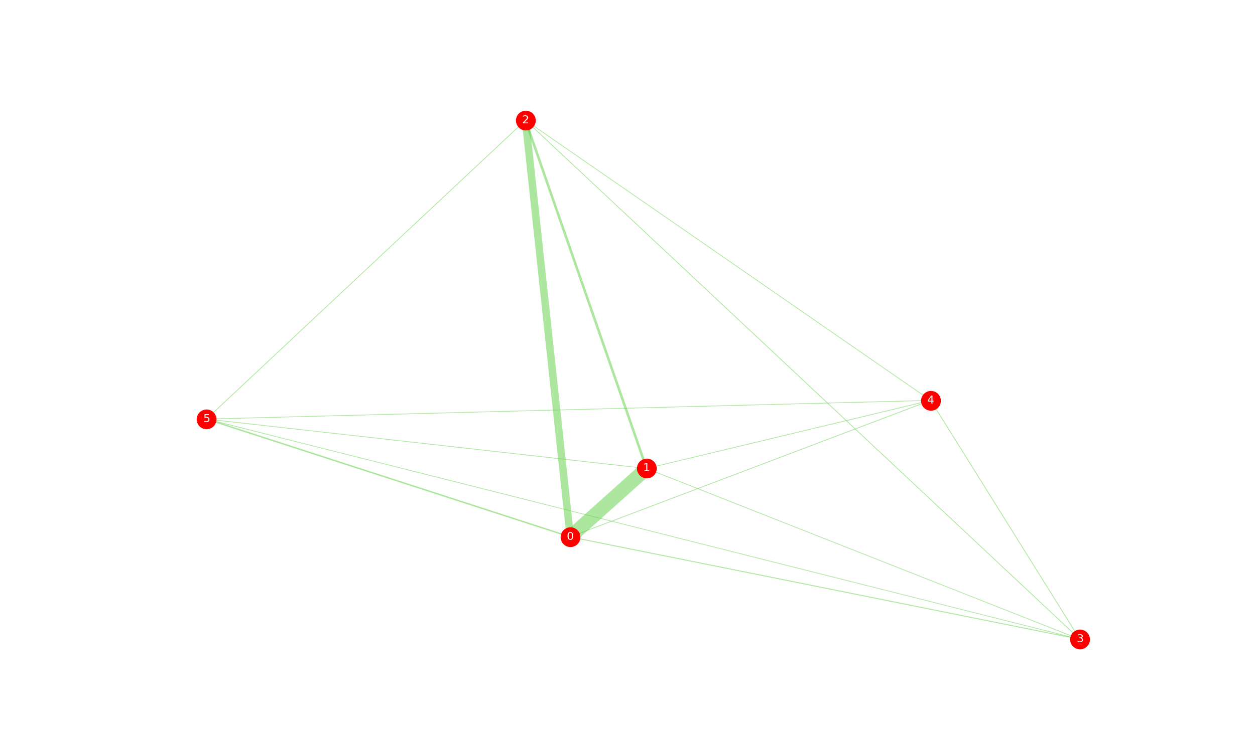

Slide 9
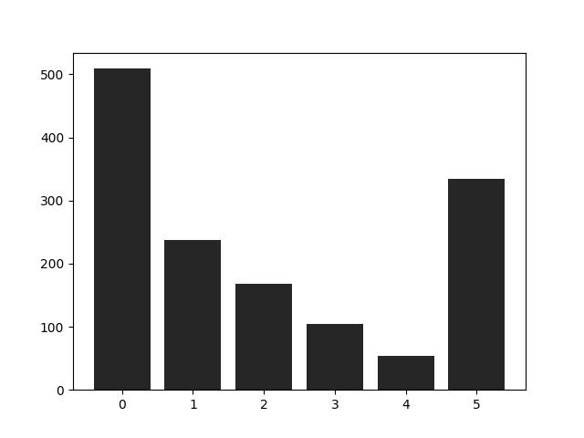
Passage Distribution

Slide 10
Potential Errors
Uneven Distribution of Passages to Clusters
Arbitrary Number of Clusters
Randomness in Initial State
Limits of Translation

Slide 11
Questions?

